Slide 1
ANT-RPS Analytics EMPLOYEE ATTRITION CASE STUDY Batch -III
Team members
Tanmay
Ruthwik
Akash
Pournima
Subhajit
Nitin

Slide 2

Business objective Understanding of the problem Approach
Section 01: Business Objective understanding and High-level Approach
A clear explanation has been mentioned in the Python file

Slide 3


Section 02: Data Health Review

Slide 4
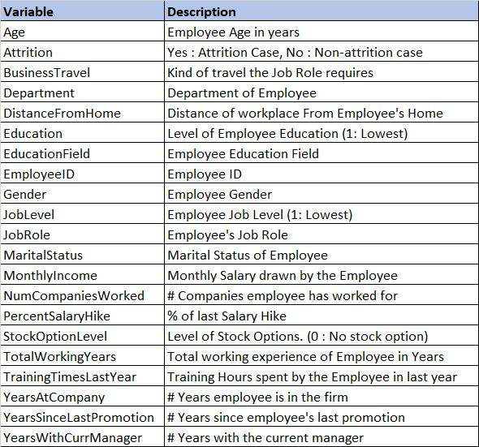
DATA DICTIONARY
Our Dataset contain 4410 Records and 21 Features

Slide 5
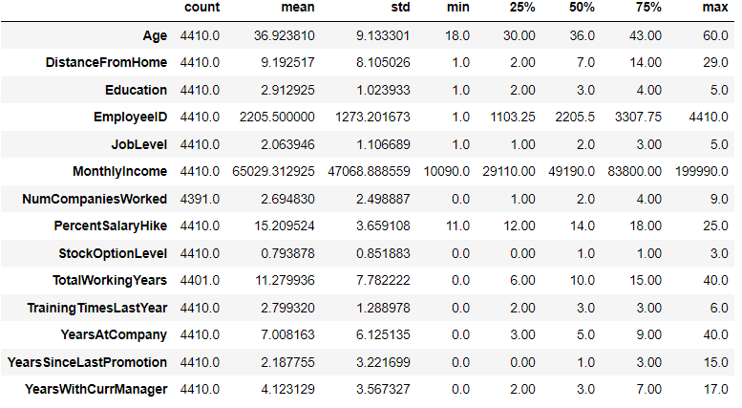
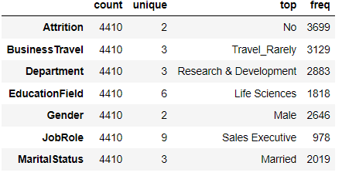
Into The Statistics
Numerical Features
Categorical Features

Slide 6
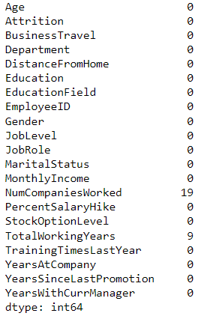
Handling missing/Null values
There are in Total 28 Null values in Two Features
Which contributes to 0.63 % of whole data.
No missing values are present.
Hence our decision of either dropping the Null values or imputing it with some values will affect the data by 0.63% . So we can go ahead and drop null values. So we ended up dropping 28 records.

Slide 7
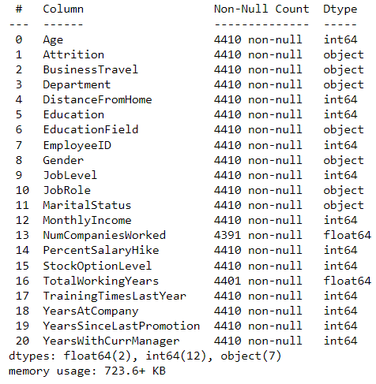
Ensuring variables are read in the correct format
Attrition Column can be further encoded for Modelling.
“NumCompaniesWorked” and “Total WorkingYears” is float datatype and can be converted to integer as the Features hold whole numbers
Employee ID, Education, and JobLevel can be converted to Objects based on requirements.

Slide 8
Addressing data cleaning requirements
Data were checked for extra spaces, special characters, or unexpected values in certain variables and cleaning was performed accordingly.
Identifying and handling duplicate
No duplicates Records were found in the dataset

Slide 9
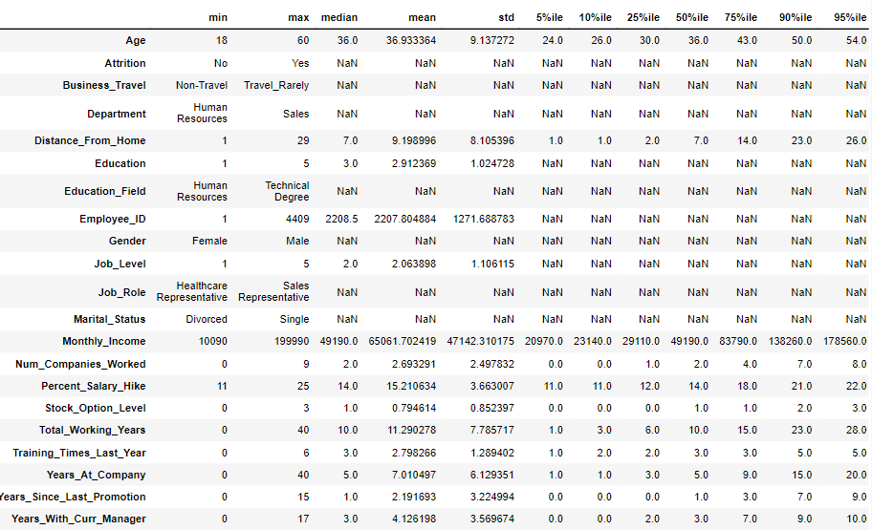

Generate Extended Data Dictionary (EDD)

Slide 10

Section 03: Exploratory Data Analysis (EDA)

Slide 11
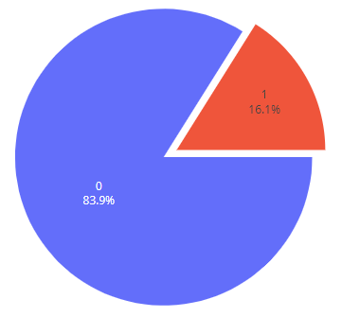
How Much is the Attrition?
The dataset is imbalanced with the majority of observations describing Currently Active Employees.
No
Yes

Slide 12
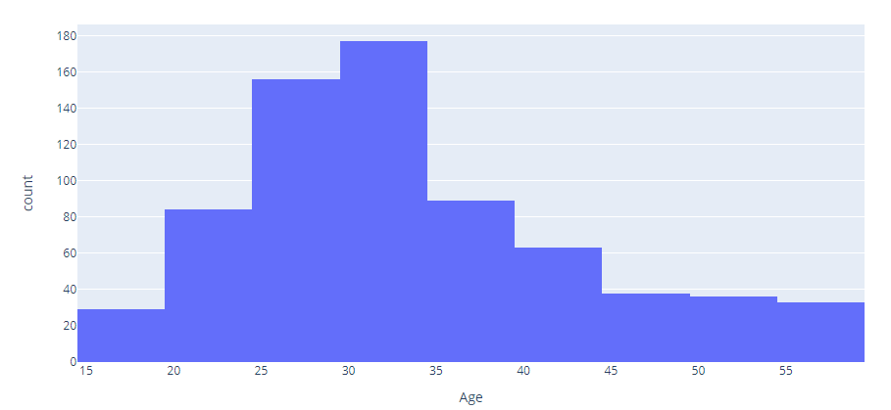
Attrition By Age
Looking at the attrition per age histogram, It's noticeable that as employees grow old, the less they tend to leave, and most of our employee attrition is made of employees ranging from 25 to 35 years old.

Slide 13
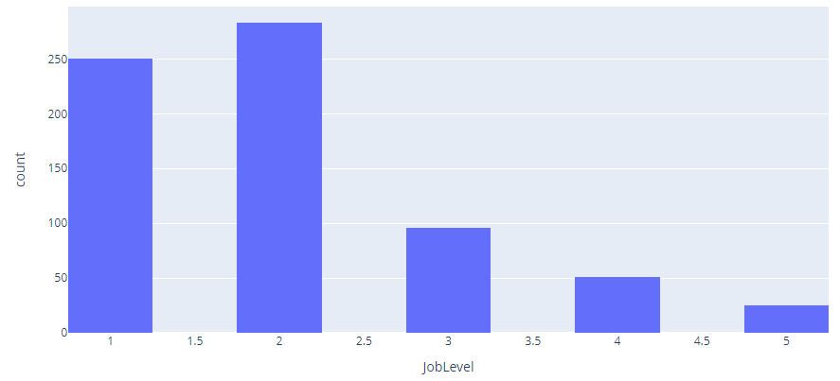
Attrition By Job Level
Most of them had a Bachelor's degree and their education field was mostly either Life Sciences, Medical and Marketing.

Slide 14
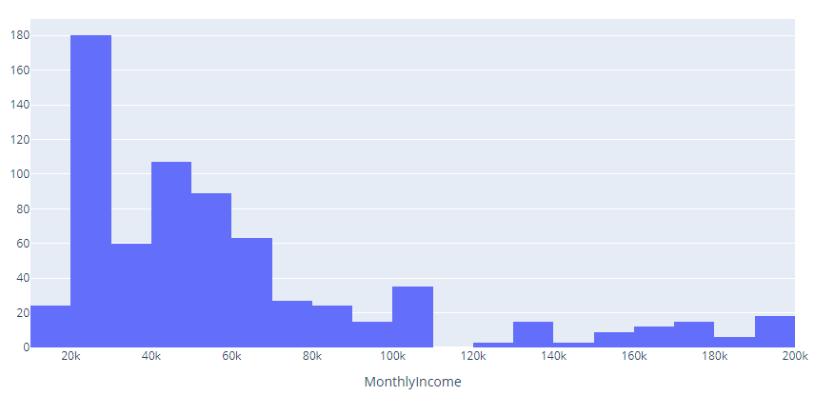
Attrition By Monthly Income
Employees with less Monthly salary tend to leave the company possibly for better compensation.

Slide 15
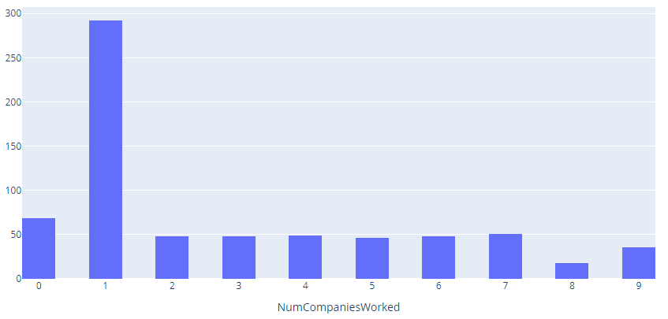
Attrition By Number of Company Worked
This Employees are probably the contractual or Interns who might have joined for gaining early industry experience.
Employees tend to look for better opportunities with a year of experience.

Slide 16
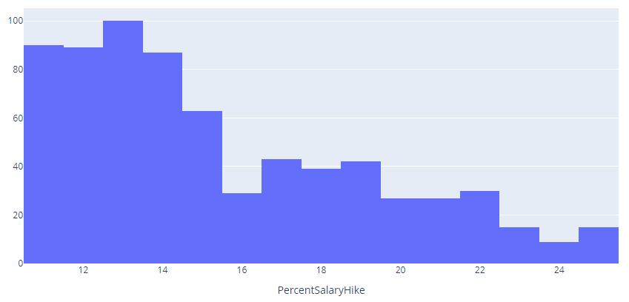
Attrition By Percent Hike in Salary
Those who've less percent salary hike tend to leave more than those with a higher precentral hike in salary.
This employees might have left for better compensation.

Slide 17
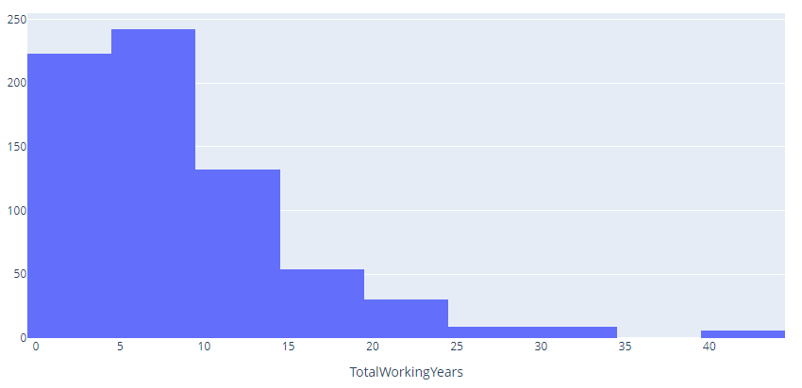
Attrition By Total Working Years
So mostly, employees who leave tend to be young, with less time working in the company and at the beginning of their career in general, since most of these employees were working for less than 10 years in total.

Slide 18
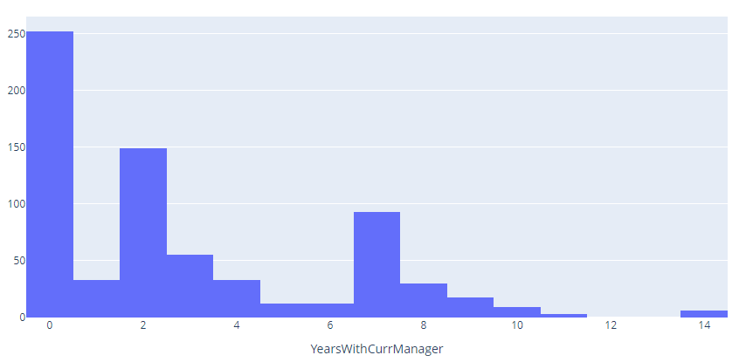
Attrition By Years with Current Manager
It's also curious to see that a lot of these employees had less than 2 years working with their last manager. Could we be having issues with some managers? How well are they trained to deal with their teams and the people they led? Are we, as a company doing the best we can to assure a good relationship between managers and teams?

Slide 19
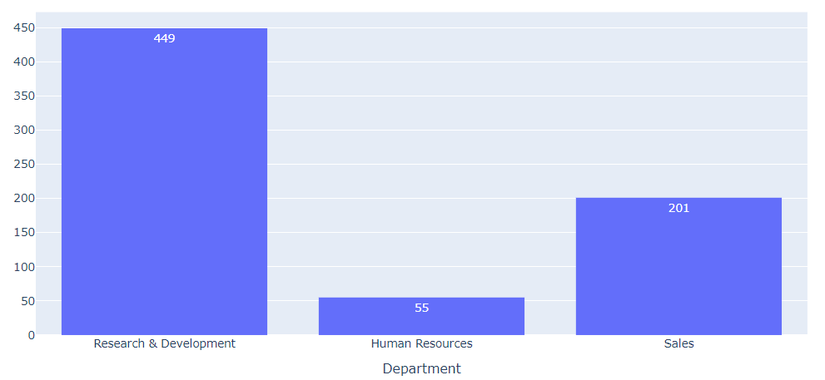
Attrition By Department
we can see that most employees who have left worked for the Research & Development department, with most of them being laboratory technicians, sales executives or research scientists

Slide 20
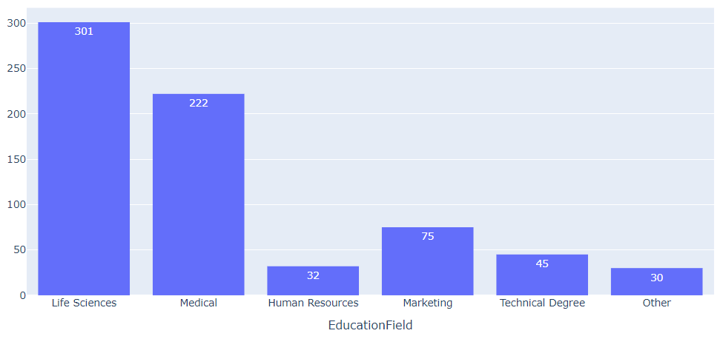
Attrition By Education Field
How can we make the work environment better? What kind of changes must be done, especially for the research and development personnel? These are important questions to be asked.

Slide 21
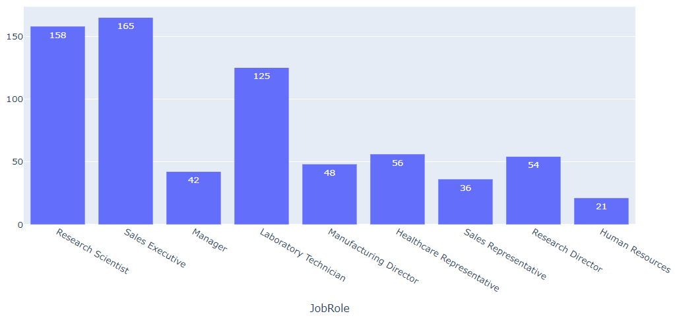
Attrition By Job Role
How can we make the work environment better? What kind of changes must be done, especially for the research and development personnel? These are important questions to be asked.

Slide 22
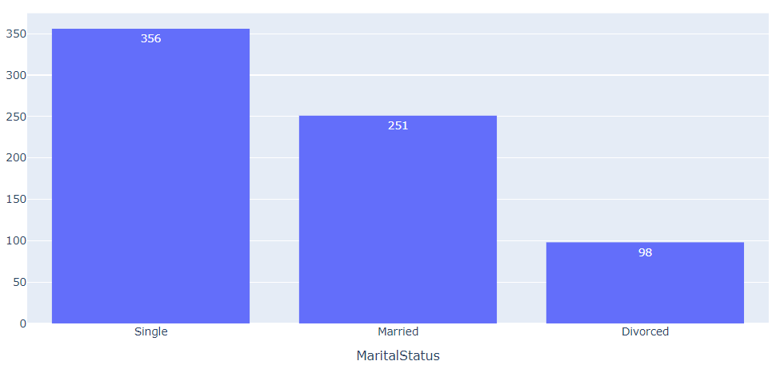
Attrition By Marital Status
The dataset features three marital status: Married (251 employees), Single (356 employees), Divorced (98 employees).
Single employees show the largest proportion of leavers at 25%.

Slide 23
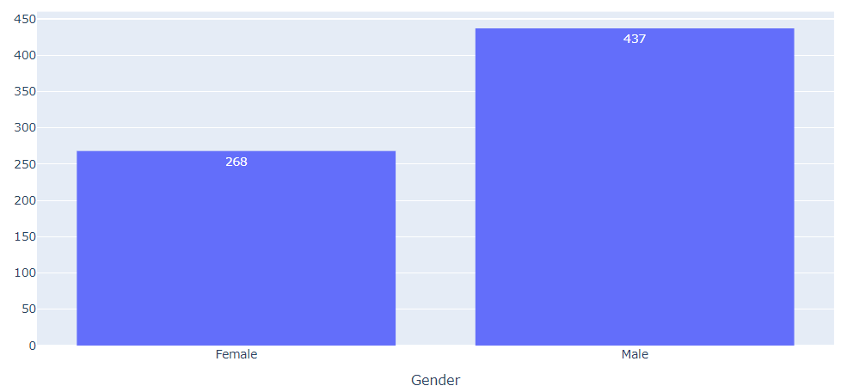
Attrition By Gender
Gender distribution shows that the dataset features a higher relative proportion of male employees than female employees, with normalized gender distribution of employees in the dataset at 17.0% for Males and 14.8% for Females.

Slide 24
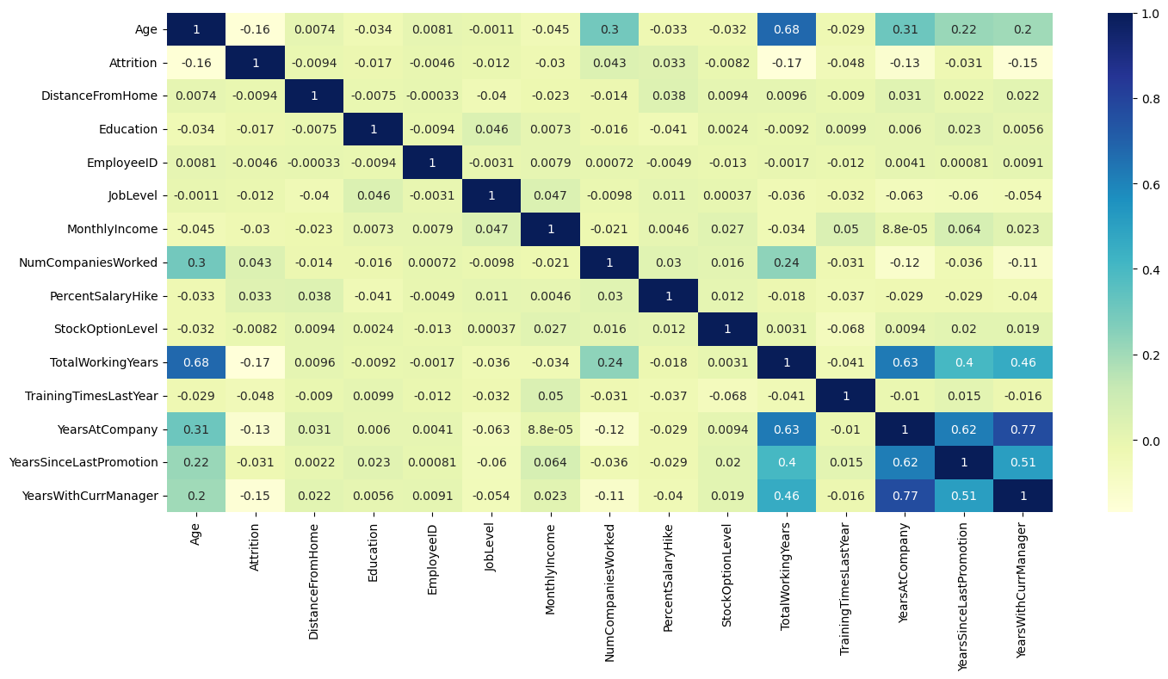
Section 03: Exploratory Data Analysis (EDA)
As shown above, "YearsWithCurrentManager","YearsSinceLastPromotion" and "YearsAtCompany" are positively correlated to Attrition,
while "Total Working Years", "Job Level", and "PercentSalaryHike" are negatively correlated to Attrition.

Slide 25
Section 04: KPI/Metric Based Questions

Slide 26
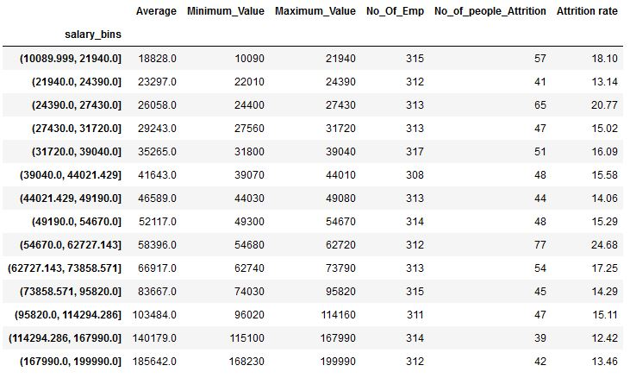

Attrition rate vary with Salary. By Using bin to create equal frequency bins and observing Attrition rate
Attrition rate For Each Bin

Slide 27
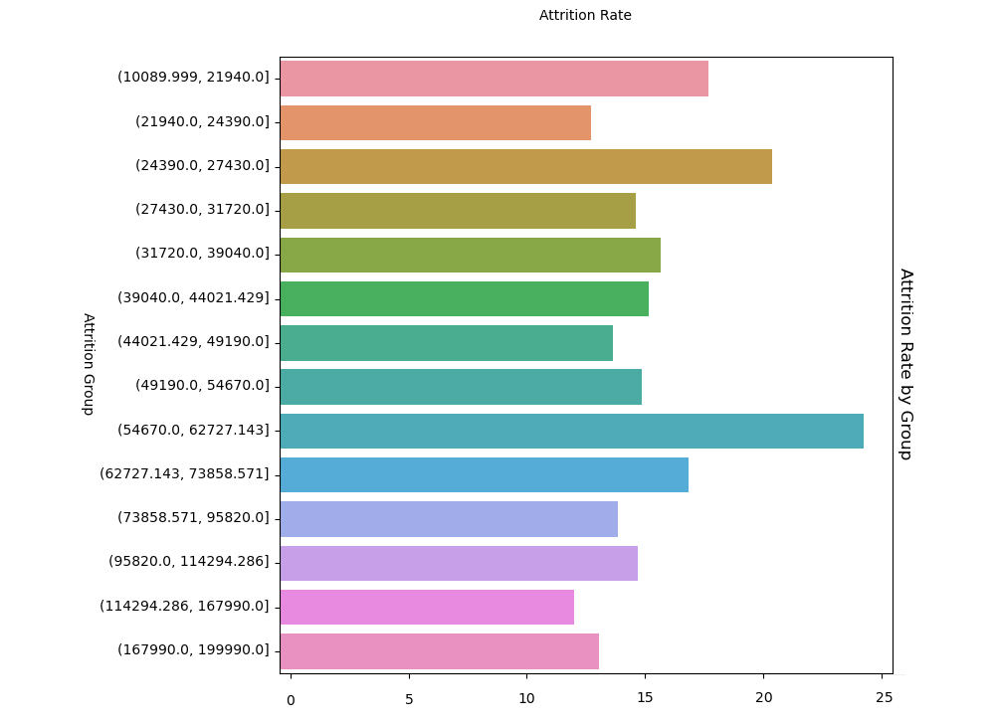
Attrition rate vary with Salary. By Using bin to create equal frequency bins and observing Attrition rate

Slide 28
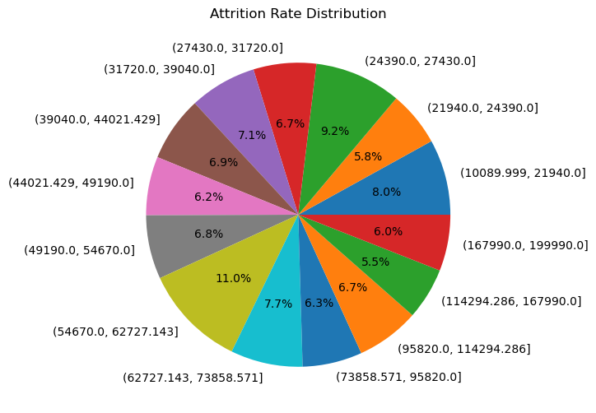
As we can observe that the for bin (54670.0, 62727.143) attrition rate was more i.e., 11.0 % compared to other bins. follows attrition rate more for the bins (21940.0, 24390.0) = 9.2%, (10089.999, 21940.0] = 8.0%, (62727.143, 73858.571) = 7.7
As we can observe that we cannot get a conclusion on binning we need further investigation.

Slide 29
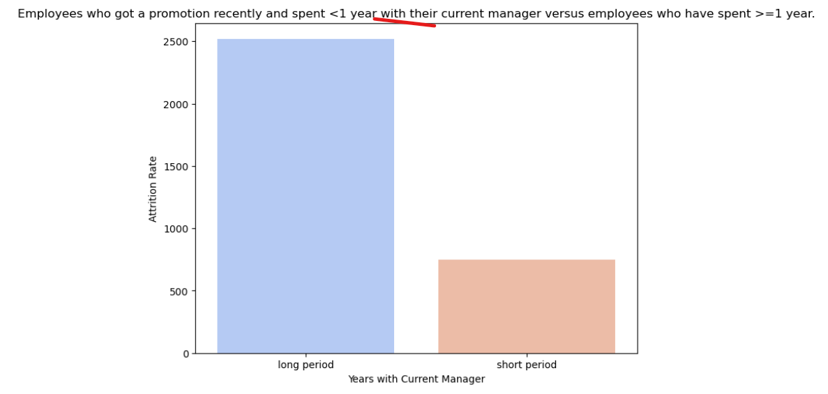

Slide 30
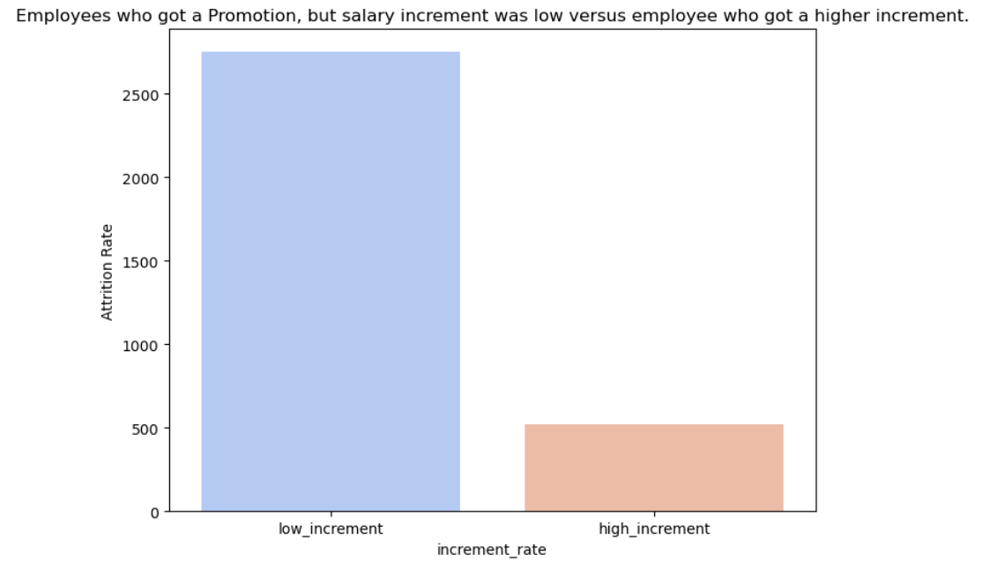

Slide 31
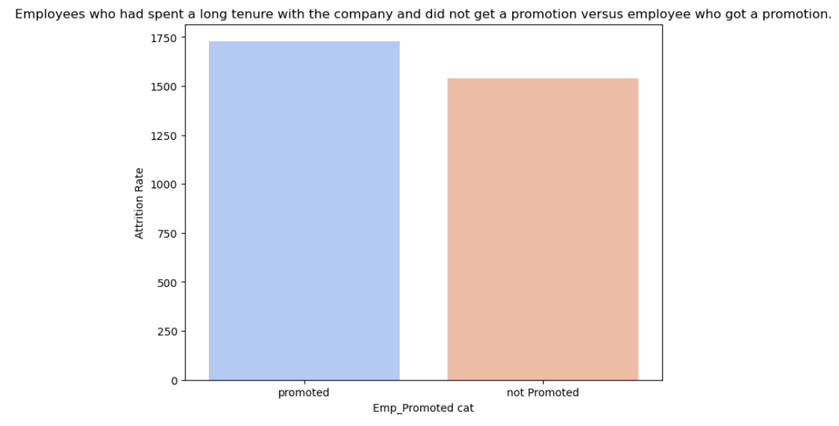

Slide 32
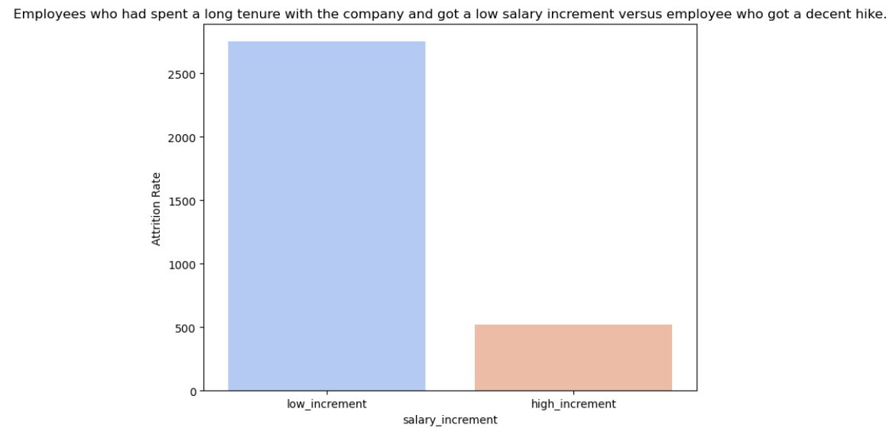

Slide 33

Section 05: Open Ended Questions and Recommendations

Slide 34
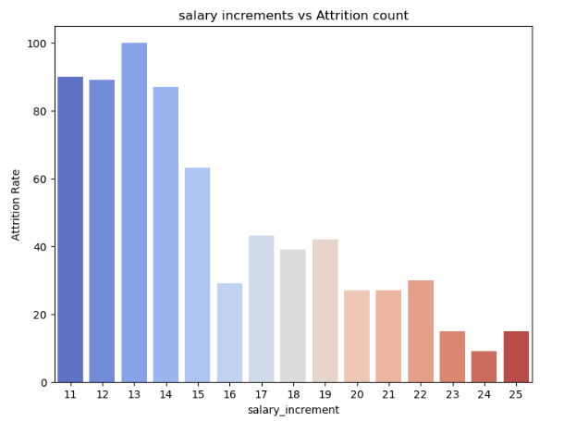
Which Are the Strong Drivers for Attrition?
Low Salary increments
Those who've less percent salary hike tend to leave more than those with a higher precentral hike in salary. This employees might have left for better compensation.

Slide 35
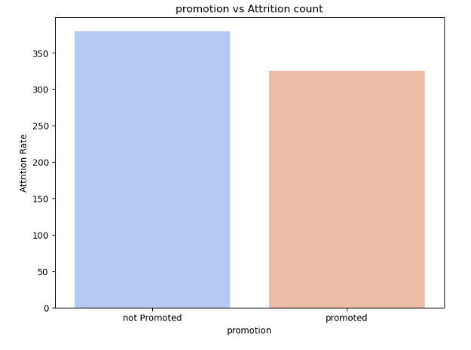
Which Are the Strong Drivers for Attrition?
No Promotion
325 Employees Who got no promotion were the one who left the company

Slide 36
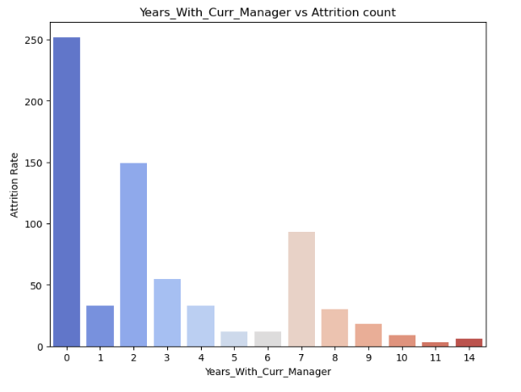
Which Are the Strong Drivers for Attrition?
Current Manager
Employees who spent less than or equal to 2 years with their manager were the one who contributed to maximum attrition.

Slide 37
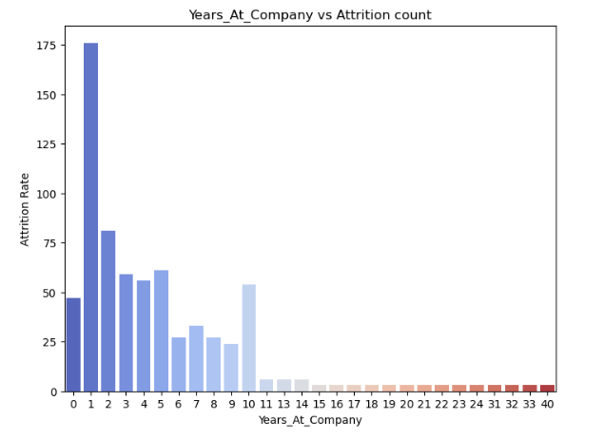
Which Are the Strong Drivers for Attrition?
Need for a change (after having served the company for long)
Employees who spent more than 10 years at company were less tend to leave the company.

Slide 38
Which Are the Strong Drivers for Attrition?
Low salary compared to Peers (with same work exp.)
Employees with less salary that that of their peers were most likely to leave the company.

Slide 39
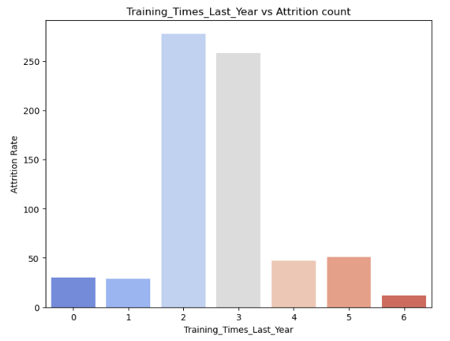
Which Are the Strong Drivers for Attrition?
Lesser training time spent in last year
Employees who spent 2 to 3 years on training left the company after getting trained

Slide 40
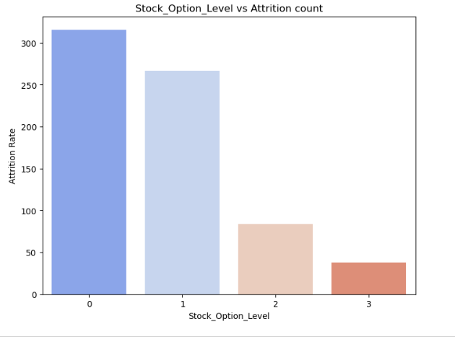
Which Are the Strong Drivers for Attrition?
Stock Options not being given
Employees who were excluded from stock option or less stocks were given as a part of CTC were most likely to leave the company.

Slide 41
Suggestions to Increase Retention
Re-looking at hiring strategy
This Employees who left are probably the contractual or Interns who have fixed term contract with employer and might have joined to gain early industry experience.
Employees tend to look for better opportunities with a year of experience. So company should introduce a policy to convert internships to full time opportunities so employees stay assured of the job security.

Slide 42
Suggestions to Increase Retention
Re-looking at overall budget for better salary increments
We suggest company to create a employee evaluation portal that will evaluate the work of a employee on annual basis and make increments accordingly.

Slide 43
Suggestions to Increase Retention
Organize Manager training to train them on people handling & management and provide mentorship.
It's also curious to see that a lot of these employees had less than 2 years working with their last manager. So we suggest company to focus on manager by providing them training on Team management and Daily work management to avoid any discrepancy between manager and team.

Slide 44
Suggestions to Increase Retention
Have more training programs that can help employees to up-skill themselves .
Employees who have spent more than 3 years at company should be selected for intensive trainings at company and the eligible employees should be give managerial opportunities.

Slide 45


